Slide 2
Program
14:00 Welcome, SCANVAC president Risto Kosonen
Adapting REHVA COVID-19 guidelines to Norway
Professor Guangyu Cao, NTNU - Norwegian university of science and technology
Danvak Covid-19 – A cross discipline project involving medical, architectural and ventilation specialists
Secretary General Claus Andreasson, Danvak and Professor Torben Sigsgaard
Control of indoor air humidity – Reasons and risks
Professor Lars Ekberg, Chalmers University of Technology, Gothenburg, Sweden
Criteria of room air cleaners for particulate matter
Professor Olli Seppänen, President of FINVAC
Questions & answers
15:45 Closing

Slide 3
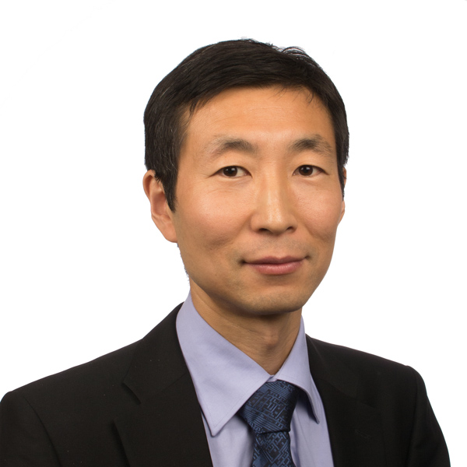
Guangyu Cao
has worked as professor at Department of Energy and Process Engineering at Norwegian University of Science and Technology since October 2014. He received his PhD degree in 2009 in Helsinki University of Technology.
His research interests are ventilation in hospitals, indoor airflow distribution, thermal comfort, indoor air quality, built environment quality and protected zone ventilation. Since 2005, Dr. Cao has completed over 80 scientific publications regarding ventilation, airflow distribution and indoor air quality in international journals and international conferences.
Currently, he is a Norwegian national representative in the European standard working group CEN TC156 WG18 Ventilation in hospitals. In addition, he is a core member and vice chair of Technical and Research Committee in REHVA - Federation of European Heating, Ventilation and Air-conditioning Associations.

Slide 4
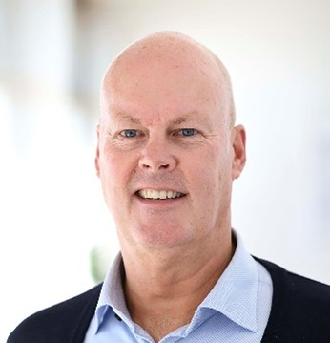
Claus Andreasson
is the Secretary General of Danvak, the Danish Society of Heating, Ventilation and Air Conditioning Engineers. Claus holds a Master of Science within Energy and Production as well as a Bachelor in Business Administration. Claus has worked within the fields of Energy and Buildings for more than 30 years.
Claus is leading Danvak, that are focused on HVAC, Indoor Climate and Energy within buildings. The ambition is to “Create better Buildings in Denmark, which increases the users well being, increases the value of the buildings and promote sustainability”. Danvaks focus for our members is “Knowledge, Innovation and value”.

Slide 5
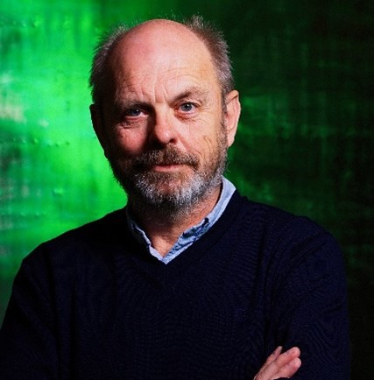
Torben Sigsgaard
is Professor and heading the Institute of Public Health, Section for Environment, Occupation & Health at Aarhus University, Denmark.
Torben’s primary research activities are all concerned with non-communicable diseases and of gene environment interaction - primarily inflammatory airway diseases including asthma and allergy and the environmental influence on allergy induction.

Slide 6
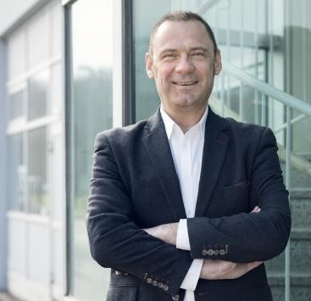
Lars Ekberg
is an adjunct professor in indoor climate technology at Chalmers University of Technology, Gothenburg, Sweden. He also works as a consultant at CIT Energy Management AB, a subsidiary of Chalmers Industriteknik.
Lars' research is focused on the chain of issues from human needs and wishes, via formulation of requirements to the design, construction and management of healthy, comfortable and energy-efficient buildings. His work spans from residential buildings on one end, to non-residential premises including schools, offices and laboratories on the other.

Slide 7
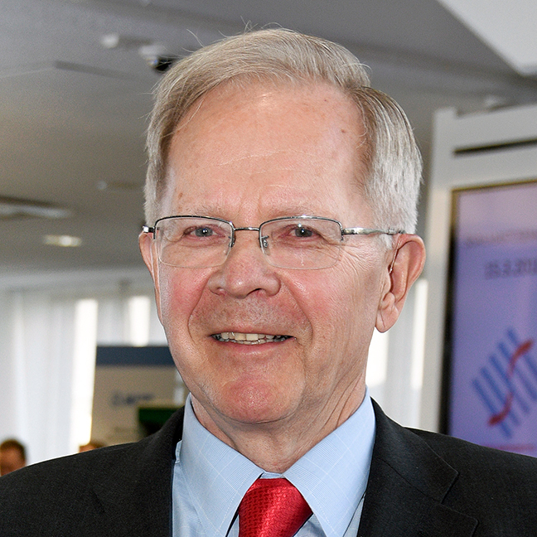
Olli Seppänen
Professor Emeritus, HVAC technology, Aalto University, Finland.
Hi is the former Secretary General of REHVA and Editor-in- chief at REHVA Journal. He has served as the President of ISIAQ, Finnish Society of IAQ, REHVA, SCANVAC and The HVAC Association of Finland, SuLVI. He is a member of ISIAQ Academy of Indoor Air Sciences, Fellow of REHVA and ASHRAE, and the Convener of Nordic Ventilation Group.
He has hundreds of publications in his main research area Indoor Air Quality and Climate.

